Slide 1
A FRAMEWORK FOR PREDICTING DRUG EFFECTIVENESS IN HUMAN BODY

Slide 2
Introduction
Drug target interaction prediction helps to identify new drugs for various diseases
The identification of drug-target interactions helps in finding new protein targeted drug and discovering new drug candidates.
Targets are specific protein molecules like receptors, enzymes, etc., that are present in the cells of human tissues.
They interact with drug molecules and confer the drug effects.

Slide 3
Existing System
Traditional methods are
ligand-based methods And Target-based methods
Ligand-based methods use ligand similarity to organize pharmacological features and associations between target proteins rather than sequence information or structural information of the target protein.
Target-based methods are highly dependent on the accuracy of target structure information.
Still these methods haven’t proved to be efficient.
Time-consuming and Expensive

Slide 4
Proposed System
Drug-target interaction prediction method based on Lasso dimensionality reduction and support vector machine
Firstly, the pseudo-position specific scoring matrix (PsePSSM) and FP2 molecular fingerprinting were used to extract the features of drug-target.
Secondly, using Lasso to reduce the dimension of the extracted feature information and then the Synthetic Minority Oversampling Technique (SMOTE) method was used to deal with unbalanced data.

Slide 5
Proposed System
Finally, the processed feature vectors were input into different classifiers to predict drug-target interactions.
This method can significantly improve the prediction accuracy of drug-target interactions

Slide 6
Diagram

Slide 7
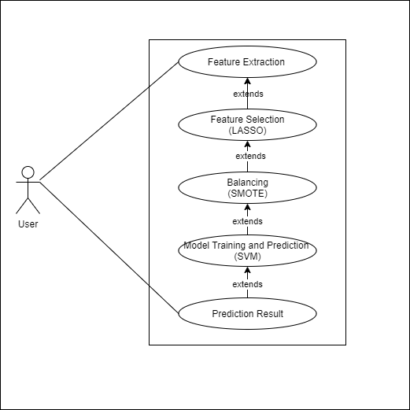
UseCase Diagram

Slide 8
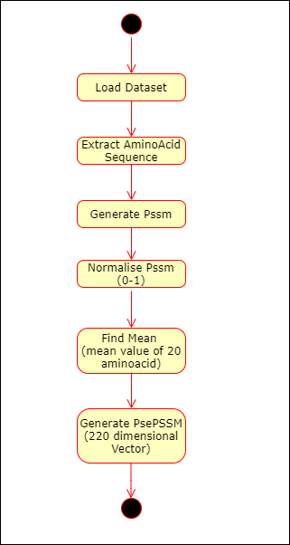
Target Extraction

Slide 9
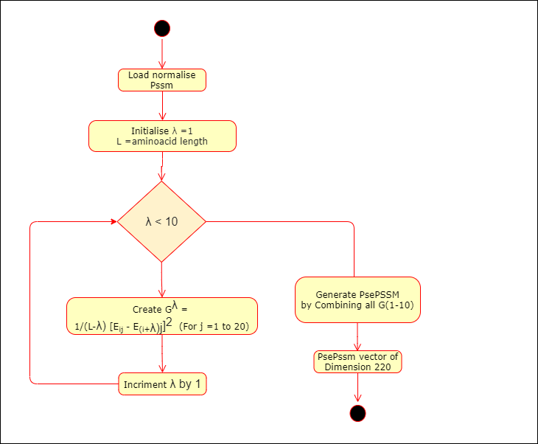
Target Extraction

Slide 10
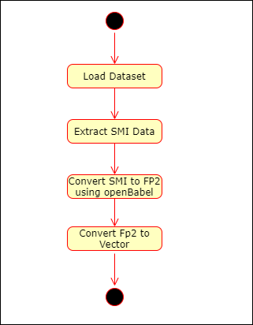
Drug Extraction

Slide 11
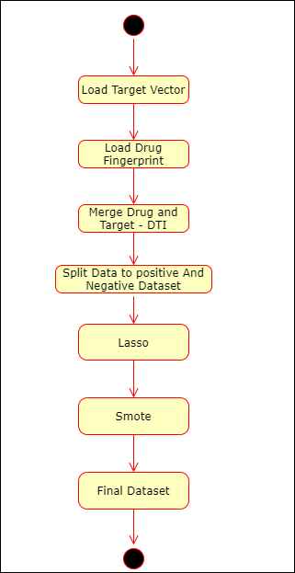
Drug - Target Interaction

Slide 12
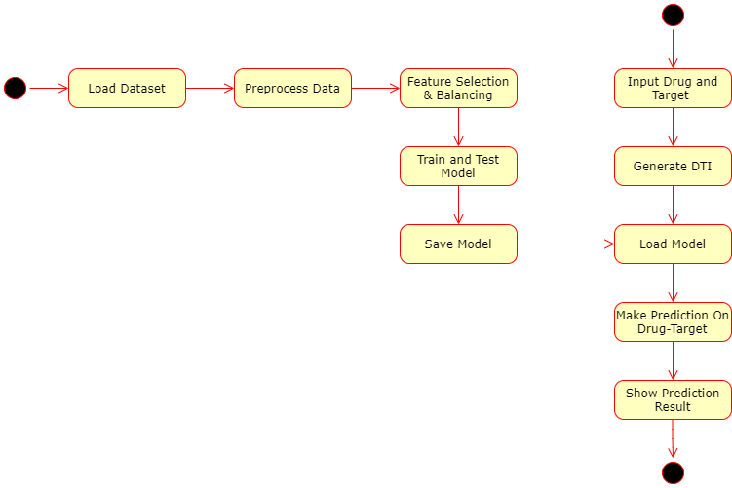
Drug-Target Interaction

Slide 13
Explanation

Slide 14
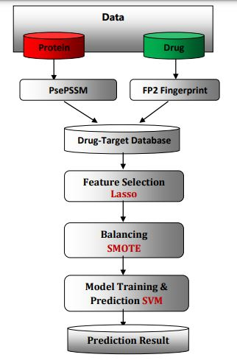

Slide 15
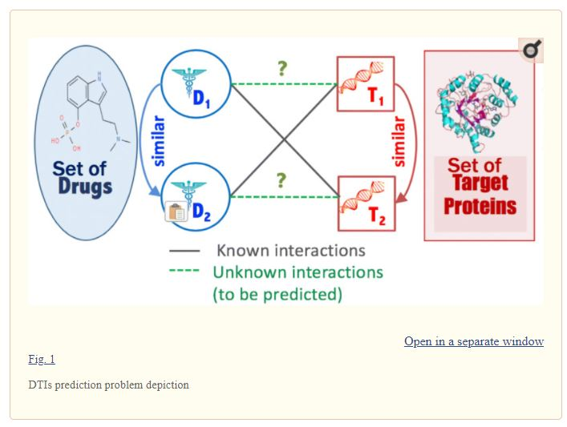

Slide 16
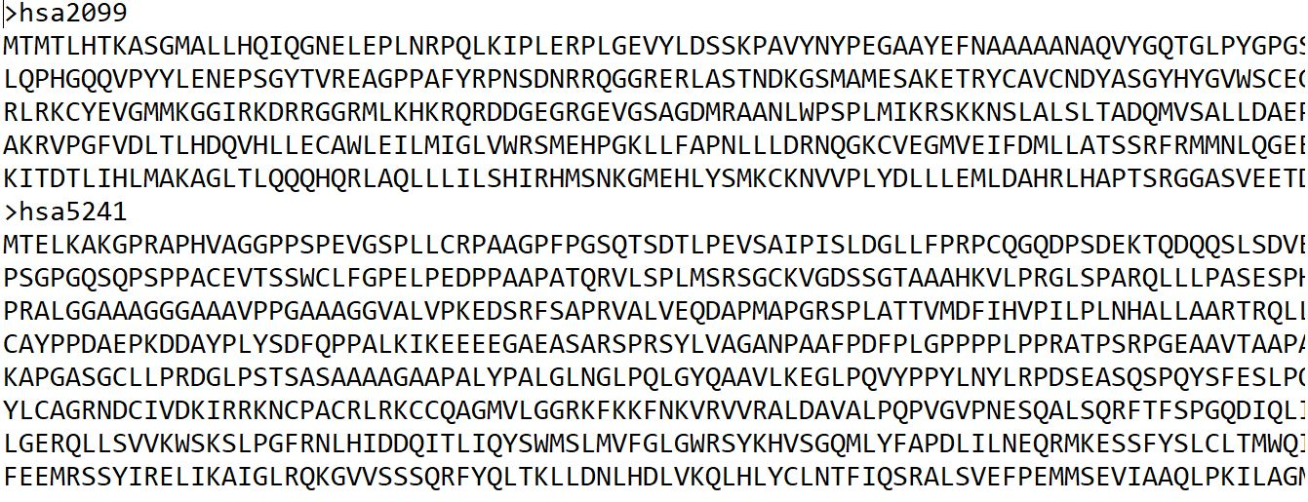
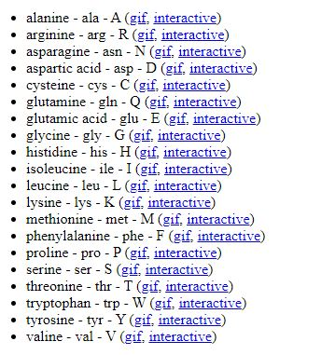

Slide 17
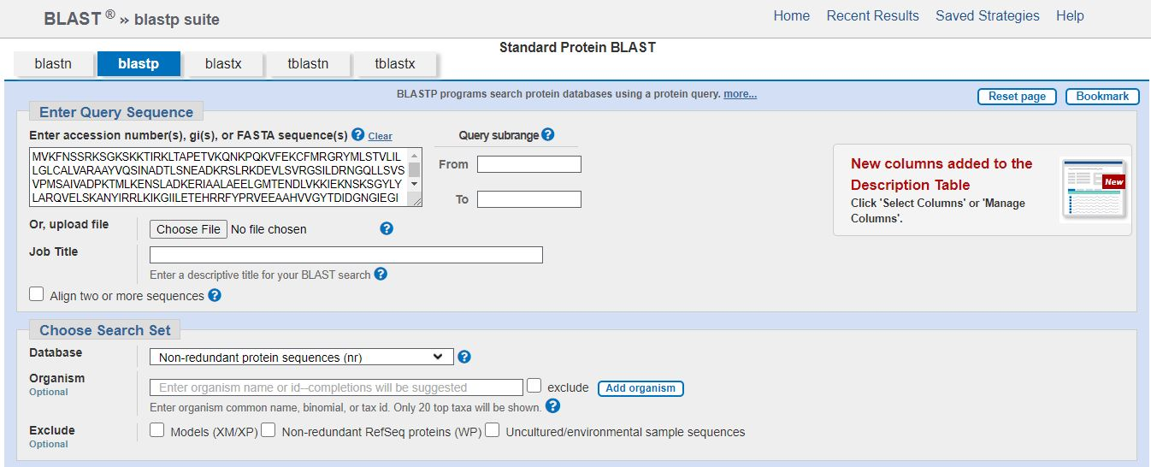

Slide 18
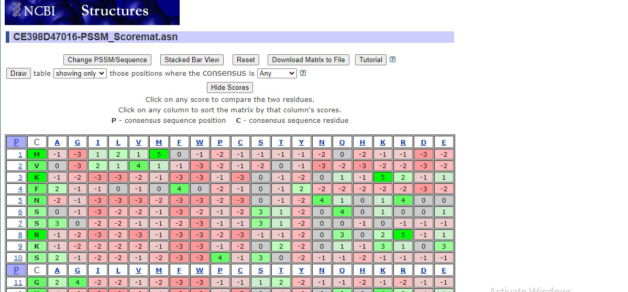

Slide 19
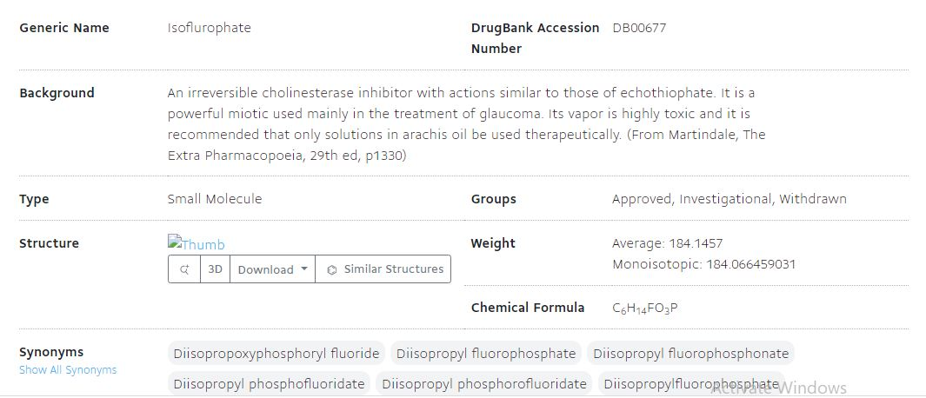

Slide 20
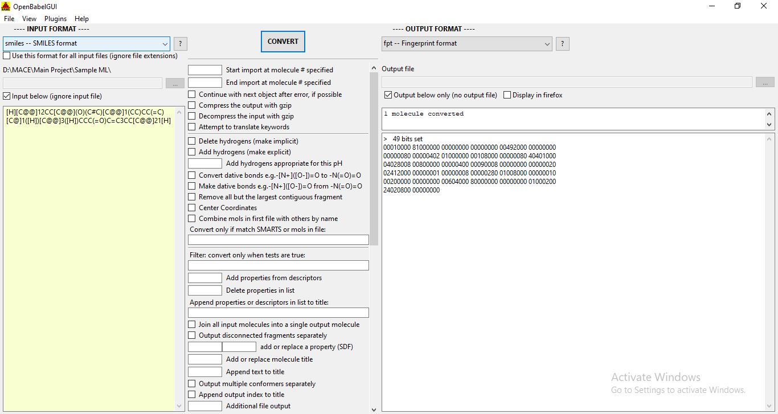

Slide 21
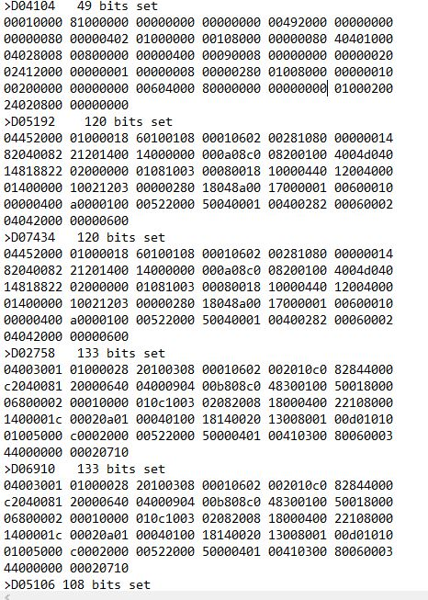

Slide 22
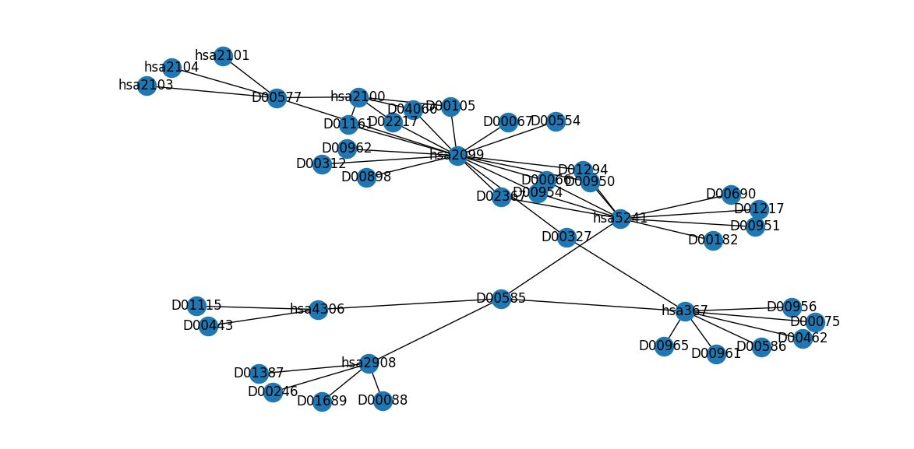

Slide 23
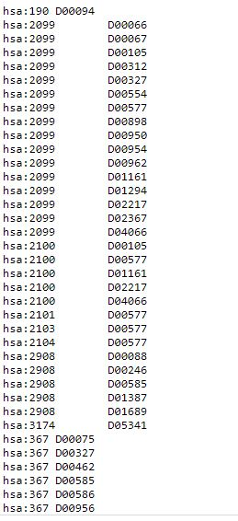

Slide 24
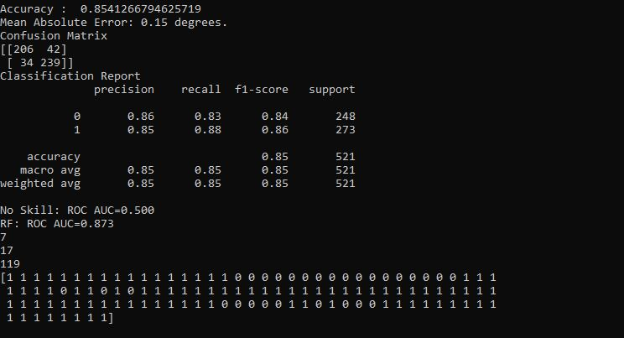

Slide 25
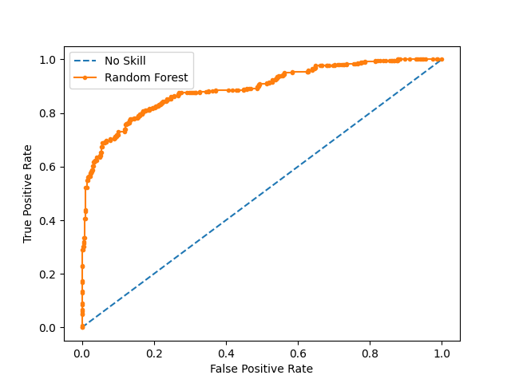

Slide 26
ThankYou...

